Slide 1
Azure Bot Service Overview
HyunSuk Shin

Slide 2





Why a bot?
TYPE
TALK
TAP
Bot builder
Cortana
Facebook Messenger
Skype
Platform services
Intelligent tools
Bing
Notes:
More natural human / computer interaction
Appealing. Efficient. Easy. Natural.
Adapts to the user depending on circumstance
Available where you are (Web, Mobile, Car, Desktop, …)

Slide 3
Demo
Litware
Notes:
•Fin Serv: https://banking.litwaredemos.com/
•Insurance: https://insurance.litwaredemos.com/
•Manufacturing: https://manufacturing.litwaredemos.com/
•HR: https://hr.litwaredemos.com/en-us
•Retail: https://retail.litwaredemos.com/
•Telecom: https://telco.litwaredemos.com/
•Healthcare: https://www.microsoft.com/en-us/research/project/health-bot/
Moksha Bellevue Link:
https://www.bing.com/search?q=moksha%20Bellevue
Contoso Cafe
https://www.bing.com/search?q=da9c224c-5e2a-4d10-8ea1-a78c8394d403contosocafebuildbot1+bot&setflight=chtbotans
Find café locations
Here are things you can say
Find café locations near me
Where can I get coffee
Find café locations in <city>
Book a table
Here are things you can say
Book a table
book a table for 2
book a table for 2 in redmond
book a table for 2 in redmond for next Thursday 3 PM
At any turn of the conversation, you should be able to provide additional information or correct a previously provided value
User: Book a table for 2 at redmond for next Thursday 3 PM
Bot: Ok, so I've got a table for 2 at Redmond, WA for 18 May at 3 PM. Is that right?
User: no make it seattle and for 4 guests
Bot: You bet, so I've got a table for 4 at Seattle, WA for 18 May at 04 AM. Should I go ahead?
…
Get help
Here are things you can try
Help
What can you do
What can I say
QnA
Here are things you can try
@help who is your ceo?
@help what are your locations?
@help do you have any openings?
Memory
Here are things you can try
Remember redmond as my favorite store
I prefer to get text messages over phone calls

Slide 4


What is a bot?
Platform
Platform services
HTTP
AI
{ Your Code }
Intelligent tools
REST Endpoint
SDK
Bot builder SDK
REST endpoint
Direct Line Protocol
Conversational and business logic
Canvas aware
Context sensitive

Slide 5



What is the bot framework?
What?
Tools for building REST websites
Services to enrich
Mechanisms for receive events
Data to debug and tools to analyze
Why?
Implements standard protocols
Modeling conversations is hard; tools help!
UI across multiple canvases is hard; cards rock!
Language understanding is hard
Common and well understood patterns
Goals
Start simple; add complexity; no dead-ends
Bot adapts to the user, based on context
Composable and intelligent controls to manage complexity
Customer’s
business logic and data
Bot connector
C#
BOT BUILDER
Bot Controls
Skype
Bing
WebChat
LUIS
Form Filling
QnA
Skype for Business
Cortana
Direct Line
Query over database via Azure Search
Third-party

Slide 6
Highlights
Improvements Everywhere!
Bot builder
Platform
Intelligence
SDK updates
Speech support
Improved dialog tools
Debugging improvements
Channel inspector
Improved tooling
New channels
Cortana
Bing
Skype for Business
Adaptive cards
Speech support
Payments
Analytics
Bot controls
Speech support
Cognitive services

Slide 7











New channels
Improvements Everywhere!
One Bot
Multiple canvases

Slide 8



New channels
One Bot
Multiple canvases
Custom skills
Business bots
LOB bots
Memory/profile
Top bots
IT managed
Speech
Bots in Bing search
Integrated auth

Slide 9
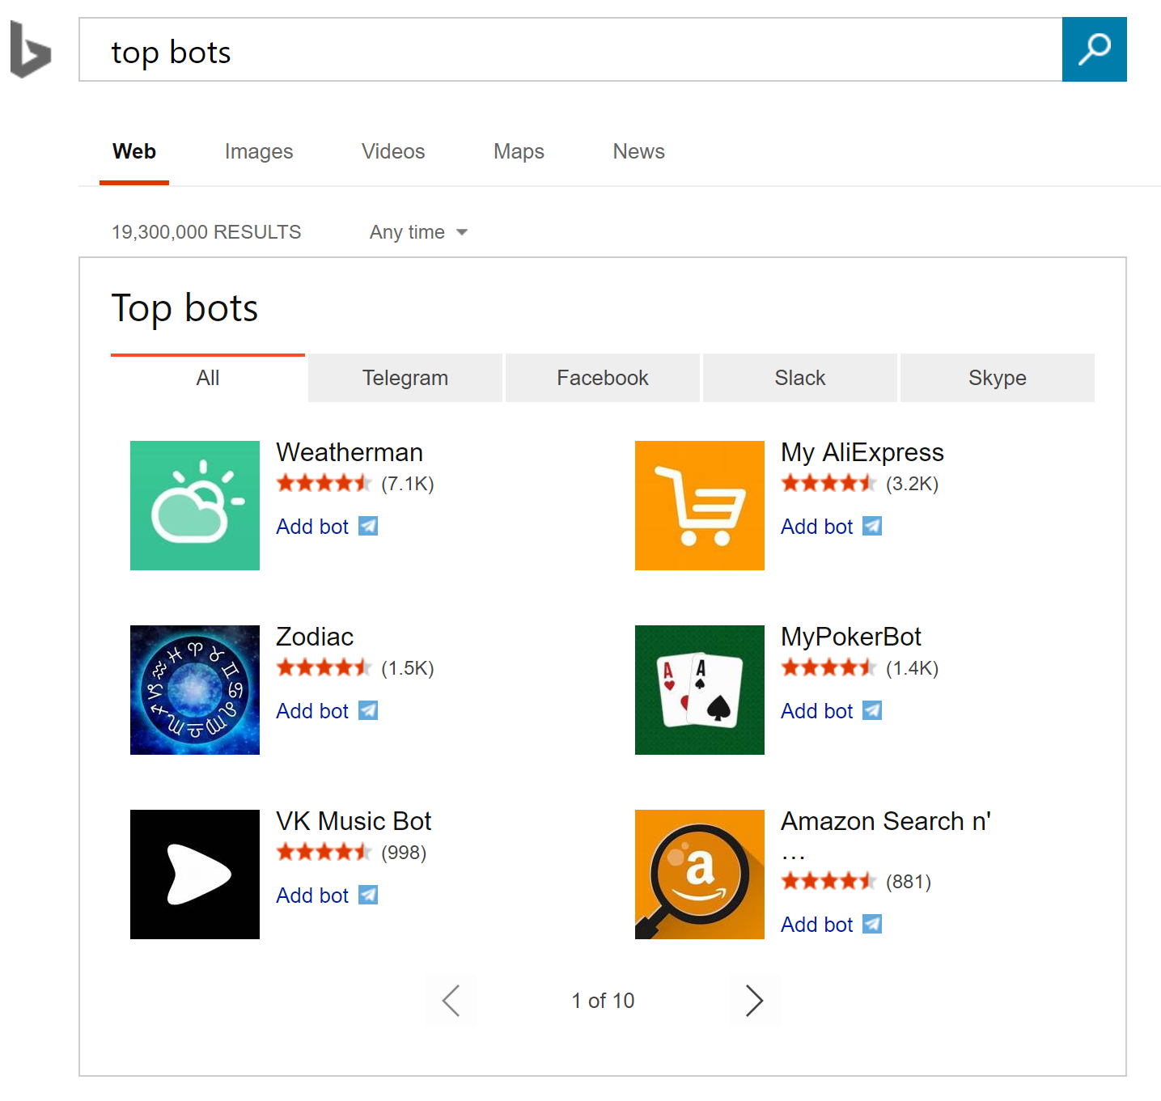
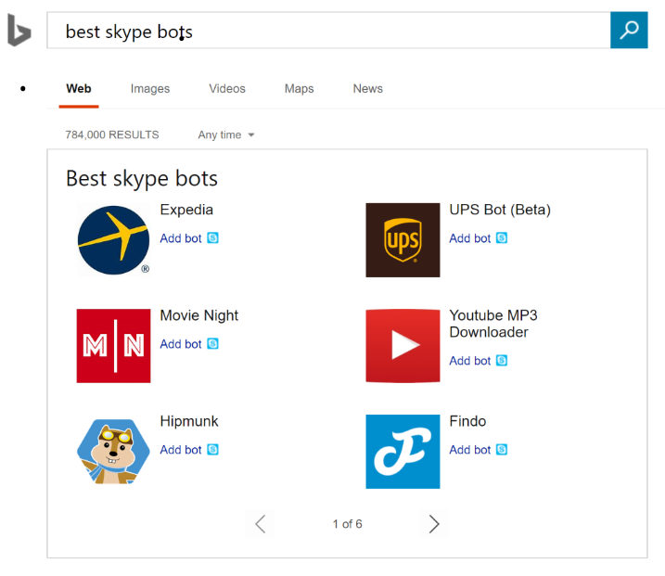
Bot discovery
Bing Search for Bots
Bing Search Terms
Top bots
Top Skype bots
Famous Skype bots
Best Facebook bots
Latest Slack bots

Slide 10
Demo
Adaptive cards
One card, multiple canvases
Notes:
http://adaptivecards-staging.azurewebsites.net/visualizer/
http://adaptivecardsdemo.azurewebsites.net/
https://github.com/Microsoft/AdaptiveCards

Slide 11

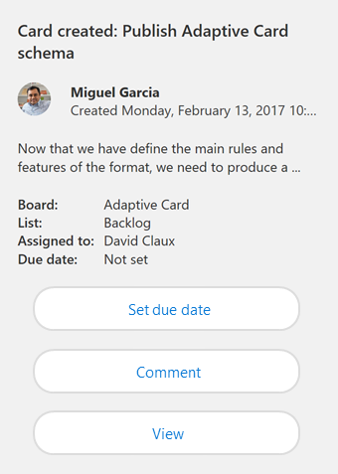
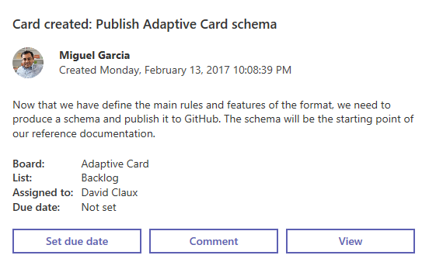
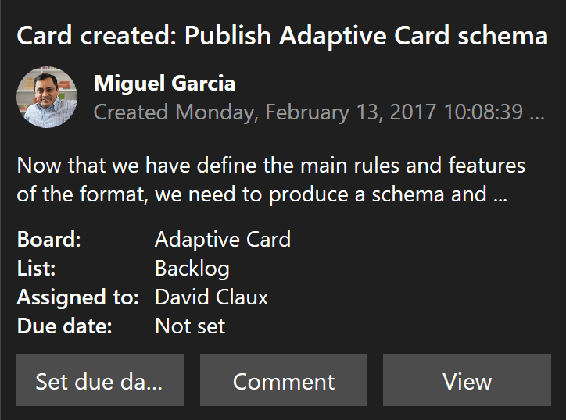
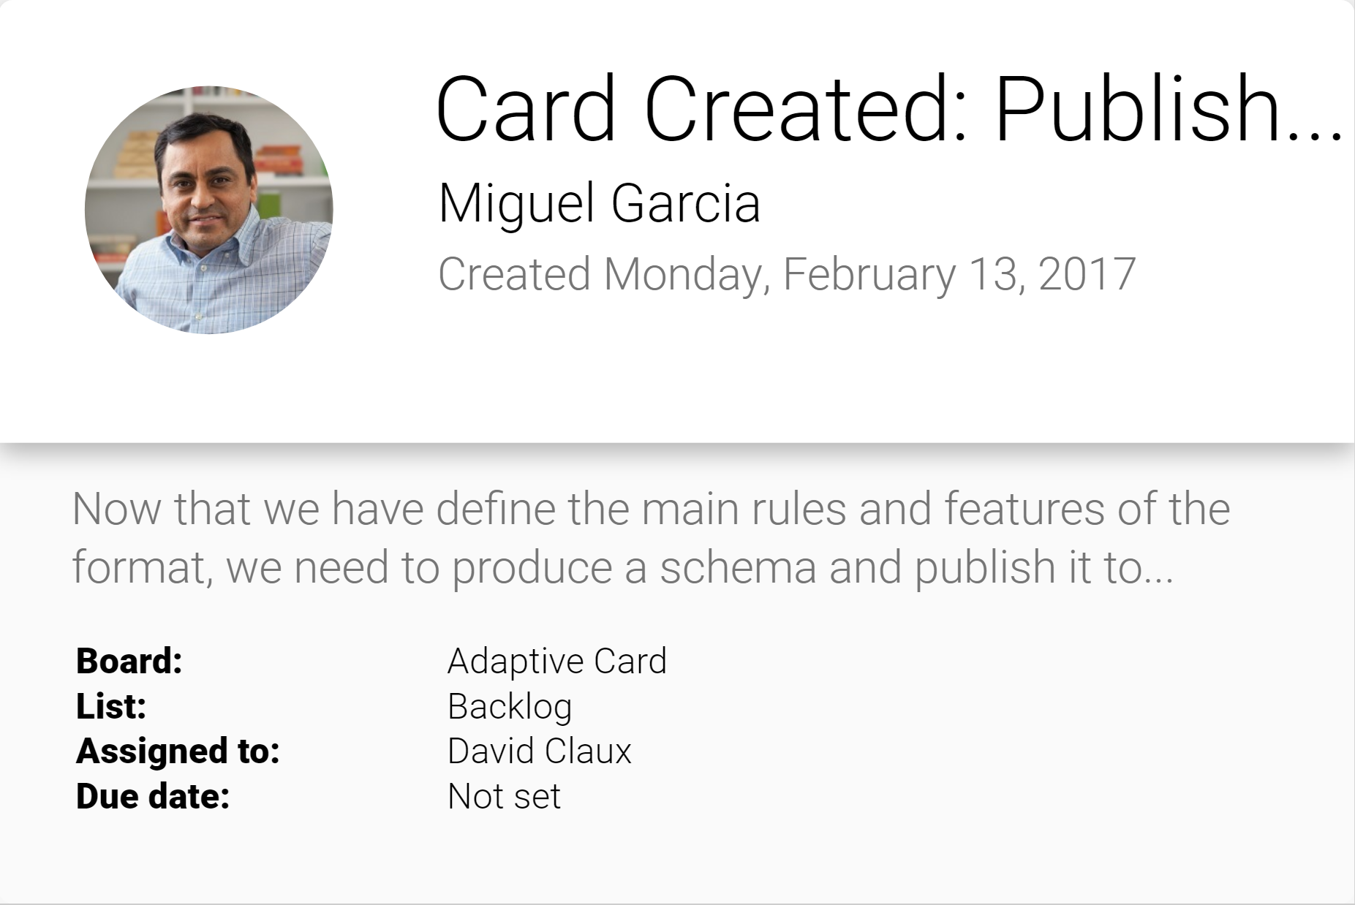
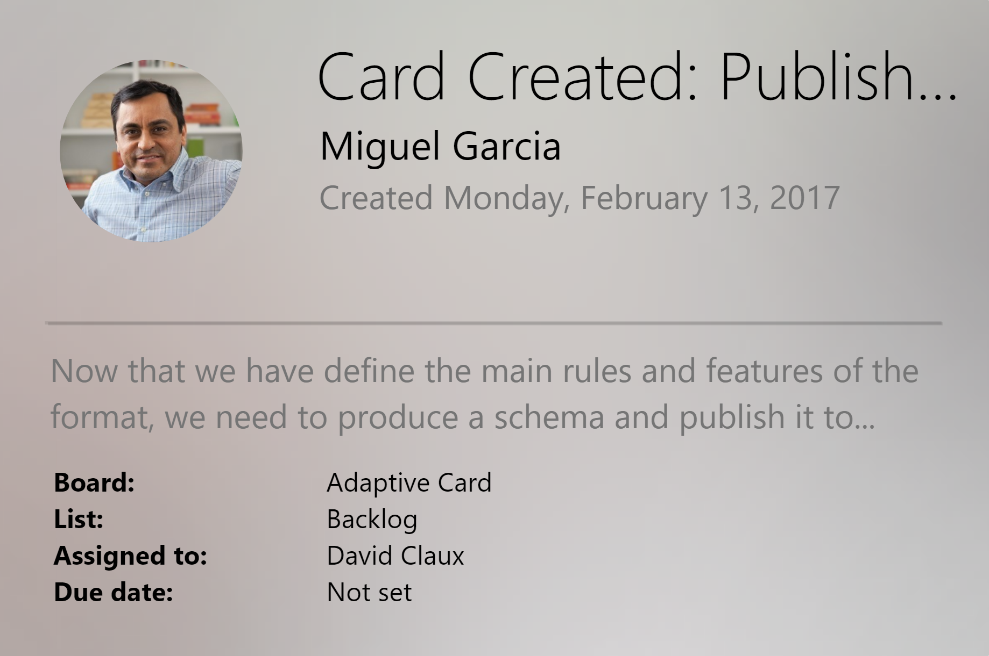
Adaptive cards
Open framework
Multiple canvases
Notification
Microsoft Teams
Skype
Android
iOS

Slide 12
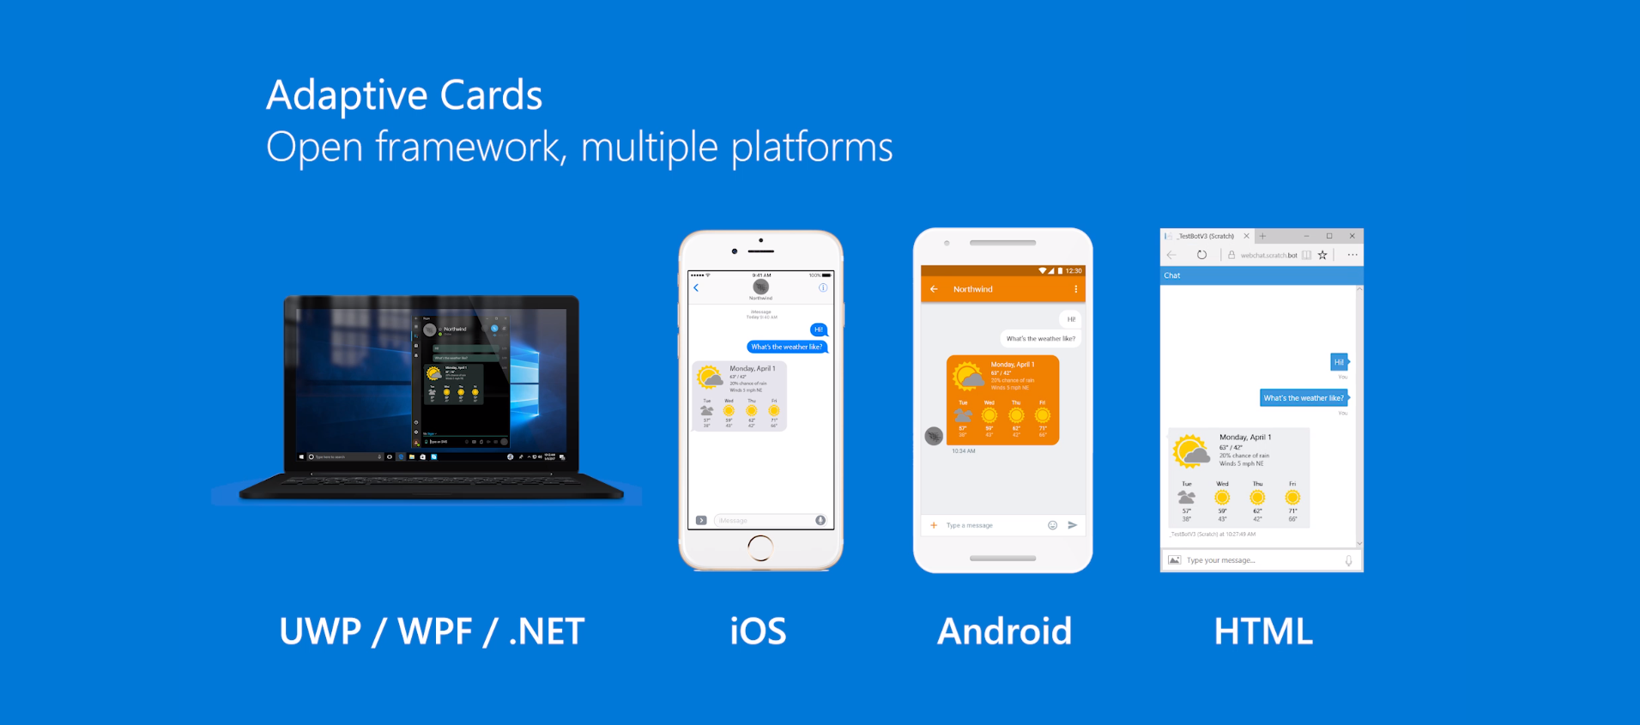
Adaptive cards

Slide 13
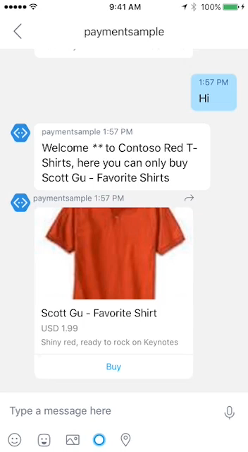
Payments
Stripe is currently supported
Visit Microsoft seller center
Obtain merchant ID
Start building
Works across most major platforms
Fast and simple payment experience
Bring commerce capabilities to your bot
Learn more on Microsoft Seller Center!
Read the integration guide for the bot framework

Slide 14
Speech
Deep Integration
Across the Bot Framework
SPEECH IN PROTOCOLS
SPEECH IN SDKS
SPEECH IN LUIS
DirectLine support
SSML
Modeled conversations
WebChat control
Speech friendly prompts
Common model (Cortana, Bing speech, custom speech recognition)
Cortana
Conversation management

Slide 15
LUIS
Language Understanding
Top requested features
More new features
Production staging and versioning
More languages (Dutch, Korean, dialects)
Increased intent and entity limits
25 customizable prebuilt domains
Lists
Improved recognizers(*)
Semantic dictionaries
Spell checking
(*) Recognizers are open-sourced

Slide 16
LUIS
Language Understanding
Pre-built domains
Examples of pre-built domains
Predefined packages
Bootstrap model creation
Customizable!
Sports
Weather
Stock
Contacts
Calendar
Restaurants
Entertainment
Fitness
Home automation
Music
Translation
Movie tickets

Slide 17
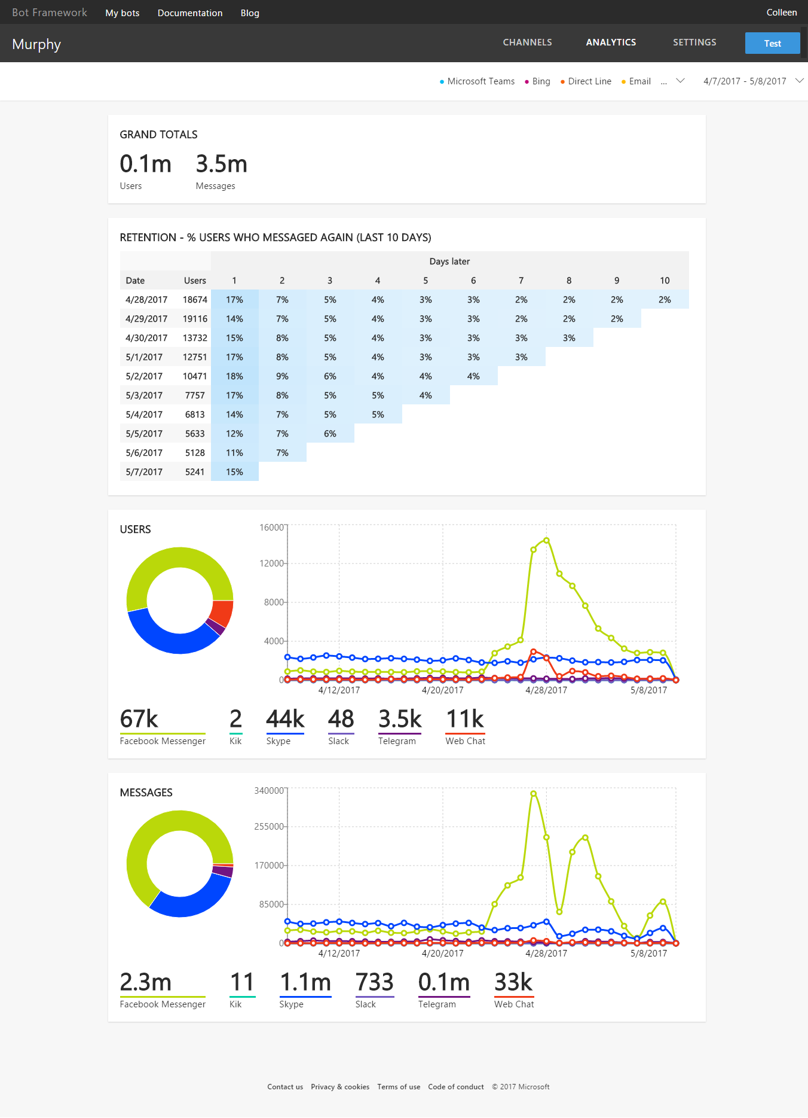
Bot analytics

Slide 18
Demo
LUIS lists and auto recommendations
Notes:
https://docs.microsoft.com/en-us/azure/cognitive-services/luis/add-features
5

Slide 19
Bot Concepts

Slide 20
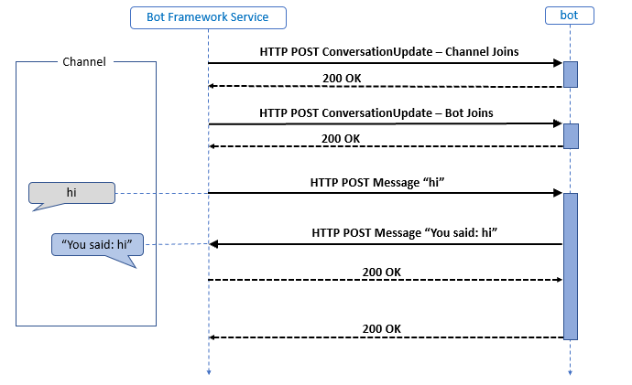
How Bot Works

Slide 21

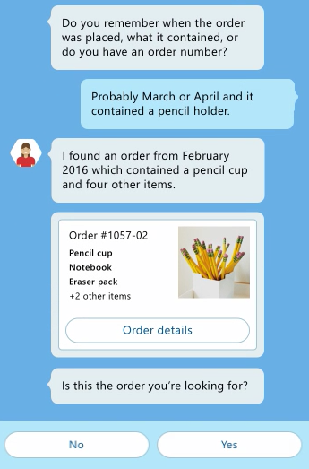
Activities
An Activity is a specific event that occurs between a bot and users, such as an actual message, or conversation notification.
Notes:
An Activity is the object or information used to communicate between a user and a bot. When an Activity is sent, there are a number of properties and methods you can use and populate to control your message and how it gets presented to a user. There are various types of Activities that can be used as well, including Activities to communicate system operations or channel system operations to the bot, enhancing the information about the bot and/or the state of the channel. Every Activity being routed through the Connector has a Type field, which is typically “Message”, however there are system notifications as well, such as “Typing”, “Ping”, or “User Data Deleted” (for when a user leaves a conversation.)

Slide 22
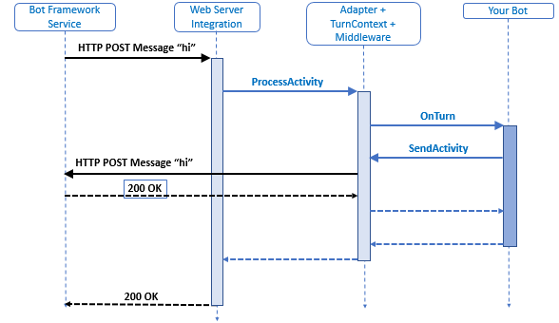
Activities
An Activity is a specific event that occurs between a bot and users, such as an actual message, or conversation notification.
Notes:
An Activity is the object or information used to communicate between a user and a bot. When an Activity is sent, there are a number of properties and methods you can use and populate to control your message and how it gets presented to a user. There are various types of Activities that can be used as well, including Activities to communicate system operations or channel system operations to the bot, enhancing the information about the bot and/or the state of the channel. Every Activity being routed through the Connector has a Type field, which is typically “Message”, however there are system notifications as well, such as “Typing”, “Ping”, or “User Data Deleted” (for when a user leaves a conversation.)

Slide 23
Types of Activities
Activity Type | Description
Message | Sent when general content is passed to or from a user and a bot
Conversation Update | Sent when the conversation's properties change, for example the topic name, or when user joins or leaves the group
Contact Relation Update | Sent when bot added or removed to contact list
Delete User Data | Send when user is removed from a conversation
Typing | Sent when a user is typing
Ping | Send when a keep-alive is needed

Slide 24
Activities.Messages
A Message is an overt communication between a bot and users, such as a user asking a question, or a bot responding with a reply.
Message Property | Description
Text | A text payload in markdown syntax which will be rendered as appropriate on each channel.
TextFormat | Plain, markdown, XML (Skype only)
Locale | Two-digit culture/region locale
Notes:
The message activity is the core object exchanged between the user and the bot. It can represent a wide range of values from simple text input and response all the way to complex multiple card carousel with buttons and actions. For many developers, the Text property is the only property you need to worry about. A person sent you some text, or your bot is sending some text back. There are 2 core properties for this, the Text and Locale property.

Slide 25
The Bot Framework Emulator
Emulate bot conversations easily on any device and any supported channel scenario.
Supports Mac, Linux and Windows
View all Bot Framework card types
Save multiple profiles for working offline
Send requests and receive responses to/from your bot endpoint on localhost
Inspect responses, and emulate specific users and conversations
Notes:
The Bot Framework Emulator is one of your most powerful tools in building your bot and supports the following:
- Works on Mac, Linux and Windows
- View all Bot Framework card types are supported
- Save multiple profiles for when you’re working both online and offline
- Simplifies configuration when you’re working with ngrok
- Uses the webchat control for higher fidelity layout and consistency with the webchat experience
- Send requests and receive responses to/from your bot endpoint on localhost
- Inspect the Json response
- Emulate a specific user and/or conversation

Slide 26
Managing State
Not all bots require state management outside of what the Connector provides inherently, however if you need to manage state, there are various methods.
Custom storage methods, such as a remote database
Class-specific logic at runtime
Implicitly during a Dialog or Form process
The Bot Framework State Client
Notes:
Not all bots require state management outside of what the Connector provides inherently, however if you need to manage state, there are various methods. For light-weight, persistent state across sessions, the Bot Framework State Client is ideal, as it retains information based on specific user data and conversational history.

Slide 27
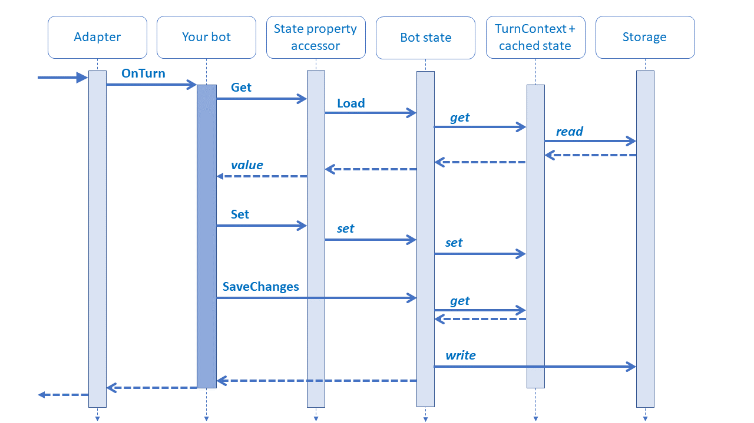
Managing State

Slide 28
Using Dialogs
Dialogs are a way of wrapping an entire “experience” into an easily managed interaction based on a “chained” and “conversational” paradigm.
Send information to a User
Prompt a User for more information or confirmation
Provide conditional logic
Provide “as you need it” content
Dialogs can contain or forward to other Dialogs
Notes:
Dialogs can help developers create simple bot experiences where a conversation and it’s elements are generally “known”. Dialogs typically leverage the concepts of “intents and prompts” to fine tune what a user really needs. Dialogs can also be nested or chained depending on the results of a prompt or dete4rmined intent, making them ideal for fundamental conversations.

Slide 29
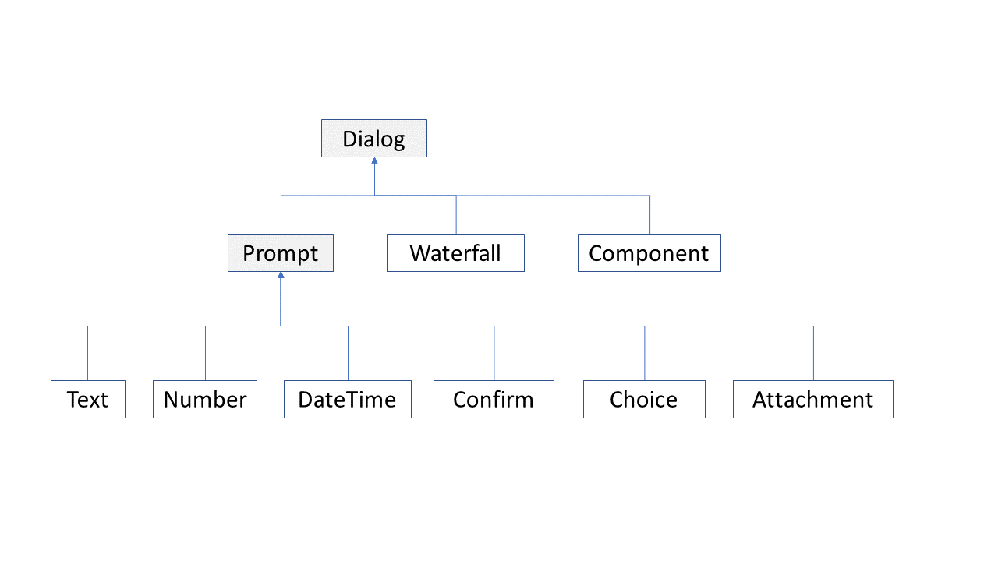
Dialog Types

Slide 30
Dialog.Prompt
Prompt | Description | Returns
Attachment prompt | Asks for one or more attachments, such as a document or image. | A collection of attachment objects.
Choice prompt | Asks for a choice from a set of options. | A found choice object.
Confirm prompt | Asks for a confirmation. | A Boolean value.
Date-time prompt | Asks for a date-time. | A collection of date-time resolutionobjects.
Number prompt | Asks for a number. | A numeric value.
Text prompt | Asks for general text input. | A string.

Slide 31
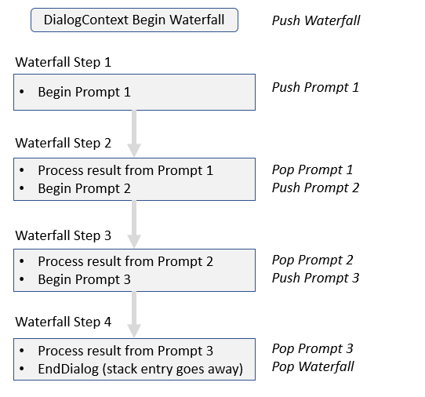
Dialog.Waterfall

Slide 32
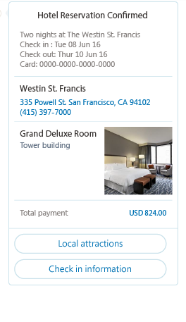
Attachments, Cards, and Actions
Bot conversations can contain enhanced content in the form of Attachments, Cards, and Actions
Media attachments: Image, audio, video, file
Rich card attachments: Hero, thumbnail, receipt, sign-in
Button and card actions: Open URL, call, play audio/video, show image, download file, sign-in
Notes:
Although not universally supported by all channels, most third-party channels provide some ability to attach “rich” objects, meaning content other than text, like audio and video, as well as the ability to have “enhanced” interactions such as viewing images and downloading files. The Microsoft Bot Framework Connector performs all the heavy lifting of connecting attachment data structure to media attachments and rich cards on each channel, and provides failover scenarios where unsupported.

Slide 33
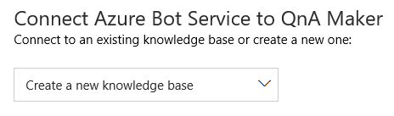
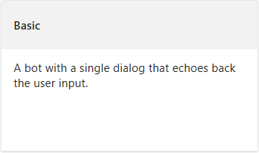

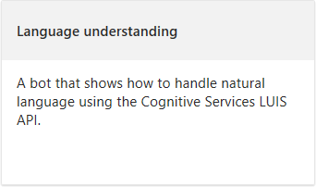
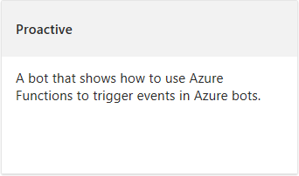
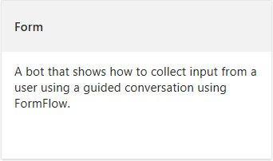
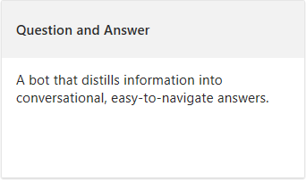
Azure Bot Services
The Azure Bot Service, powered by the Microsoft Bot Framework, provides and integrated environment for managing bot logic and integration, including the ability to edit services without the need for a local editor or source control.
Notes:
You can expedite your bot development by leveraging Azure Bot Services, an Azure-based service that provisions and configures dependent services automatically, as well as providing an integrated environment where you can build, connect, deploy and manage bots.
Azure Bot Services also speeds up initial development by providing out-of-the-box templates to get a developer started, including templates for a basic bot, LUIS bot, form bot, proactive bot, as well as a question and answer (Qna) bot.

Slide 34
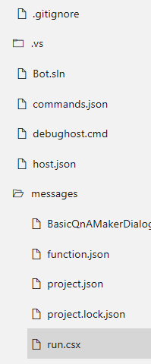
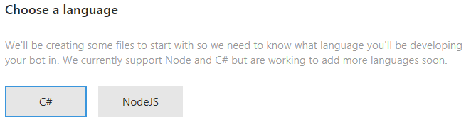
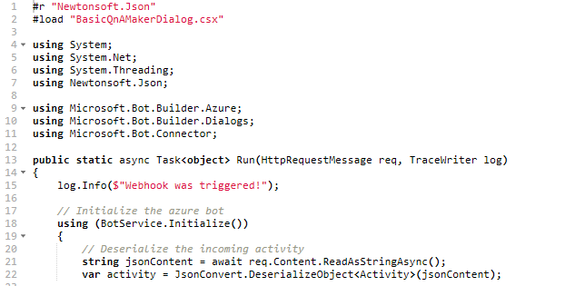
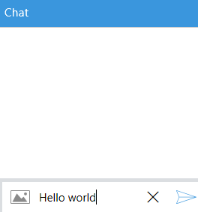
Azure Bot Services
Bots can be created and managed within a browser directly, in both C# and Node.js, using the Azure editor, effectively removing any need for a local editor. You can quickly test your bot directly in the Azure service environment.
Notes:
You can write your bot in C# or Node.js directly in the browser using the Azure editor without any need for a tool chain (local editor and source control). The integrated chat window sits side-by-side with the Azure editor, which lets you test your bot on the fly as you write the code in the browser.
Azure Bot Service is powered by Microsoft Bot Framework and Azure Functions. By using Azure Functions, your bot will run in a serverless environment on Azure that will scale based on demand.

Slide 35
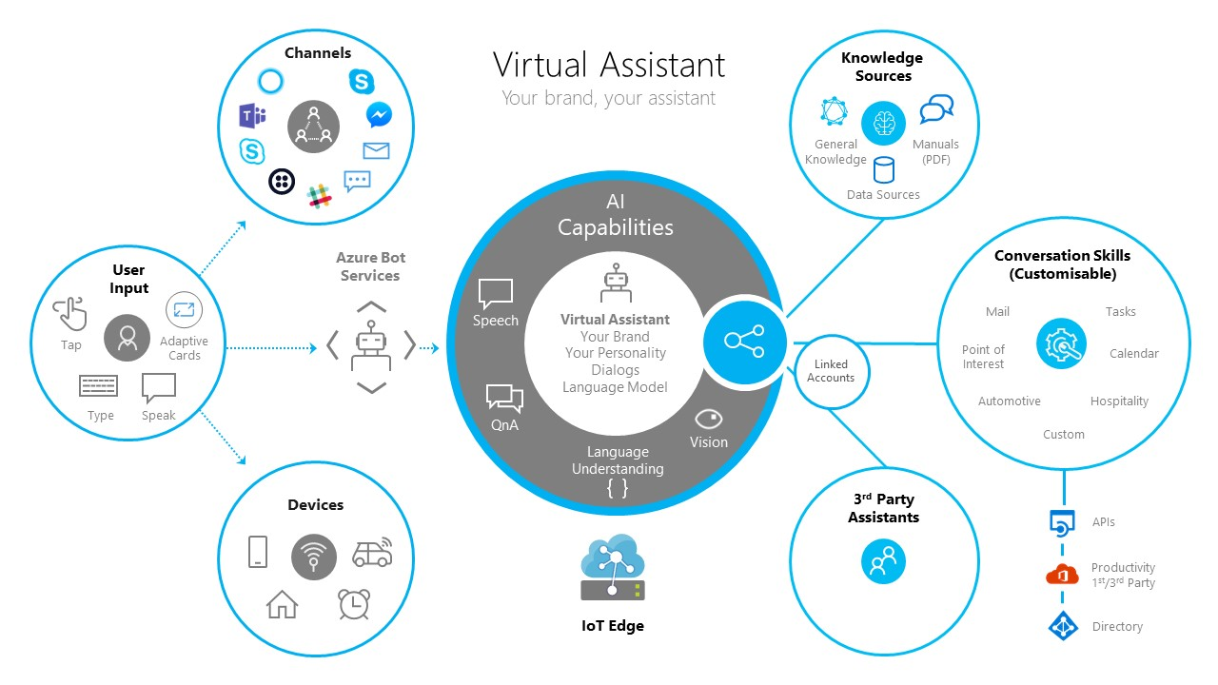
Templates

Slide 36

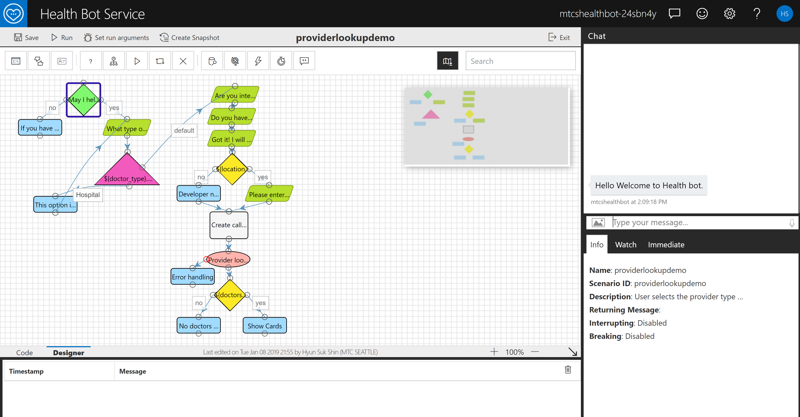
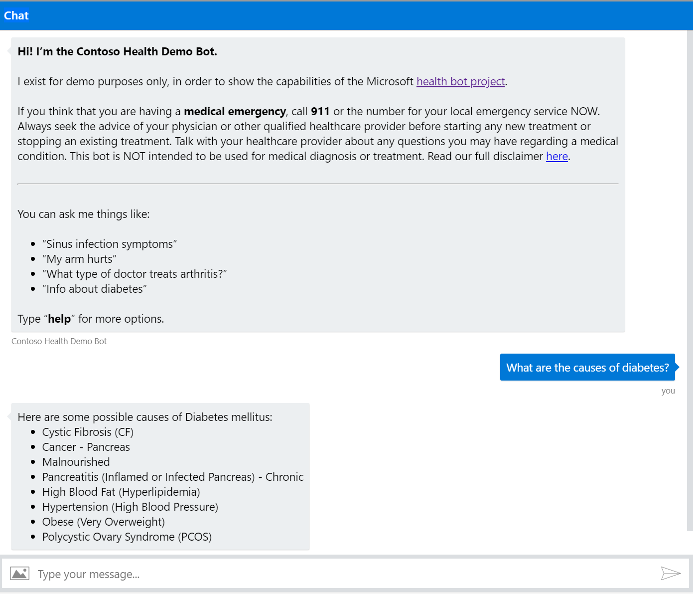
Templates
Health Bot
Health Bot Service is a SaaS solution
https://docs.microsoft.com/en-us/healthbot/index

Slide 37
Questions?
Contact

Slide 39
Intents and Prompts
Mechanisms leveraged by the Microsoft Bot Framework to determine what a user really wants to do are typically referred to as intents and prompts.
?
Notes:
The Microsoft Bot Framework ships with a number of built-in prompts, such as number, text, and confirm, to help a bot determined what a user really intends, or to refine choice during the course of a conversation. These built-in prompts are implemented as a Dialog so they’ll return the users response, typically in a “waterfall” fashion. The built-in prompts also let the user cancel an action by saying something like ‘cancel’ or ‘never mind’ or even “start over”.

Slide 40
Bot example Azure Services integration via SMSG
Task completion and general knowledge are fundamental to every Bot we deliver
Language understanding, translation, spellcheck, and sentiment cognitive services are key
Dynamics 365 Knowledgebase provides a comprehensive and agile way to provide general knowledge to the Bot and tooling to the customer to manage knowledge and feedback and to manage support cases
Application insights provides highly impactful insight into technical and end user value

Slide 41

Bot framework surface area
Bot builder
Tools for conversational modeling, bot memory, and integration of business logic
Core platform Provide developer broad access to Microsoft customers via Microsoft properties
AI and resources Democratization of AI resources such as language understanding, QnA Maker, and other cognitive services

